Slide 1
Chatbots Development with Deep Learning
Comparison of Multiple Chatbots
Features Exploration for Deep Learning Chatbots
Chatbots in Action
Shahzaib Hamid
AI Sciences Instructor

Slide 2
Module Overview
Conventional Chatbots vs. AI Chatbots
Generative Chatbots vs. Retrieval Chatbots
Deep Learning Chatbots
Chatbots in Actions
Comparison
Comparison
Benefits
Healthcare
B2B
E-commerce

Slide 3
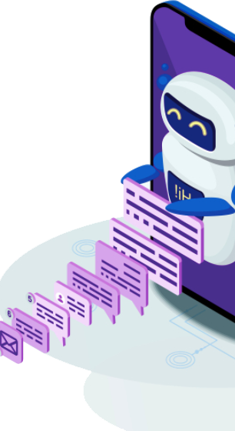
Conventional Chatbots vs. AI Chatbots
Comparison
Conventional Chatbot
AI Driven Chatbots
Periodic Upgradation Required
Keyword-driven
Manually Drafted Rules
Difficult to Train
Difficult to Scale
Powered by Deep Learning
Learn from Real Interaction
Easy to Train
Understand Variety of Questions
Understand Spelling Mistakes

Slide 4
Generative Chatbots vs. Retrieval Chatbots
Comparison
Retrieval Chatbots
Generative Chatbots
Use predefined responses
Doesn’t Generate New Insights
Based on Simple Techniques
Unable to Handle Unseen Cases
Don’t rely on predefined Reponses
Use Machine Learning Techniques
Hard to Train
Grammar Mistakes
No Grammar Mistakes
Require large amount of training

Slide 5
Deep Learning Chatbots
Benefits
Personalized Services
Simple process
Improved Customer Experience
Resource Saving
Customer Care Improvements
Service Integration Opportunity

Slide 6
Chatbots in Action
Medical Domain
Benefits
Schedule Appointments
Checking Symptoms
Provide Support and Relevant Information
Coverage and Claims
Improves Patient Experience
Helping with Therapy

Slide 7
Chatbots in Action
Business-to-Business
Lead Qualification
Lead Nurturing
Data Mining

Slide 8
Chatbots in Action
E-Commerce
Personalized Services
Real-time Interaction
Storytelling
Collect Feedbacks
Provides Metrices
Lead Generation
Rich Analytics

